Slide 1
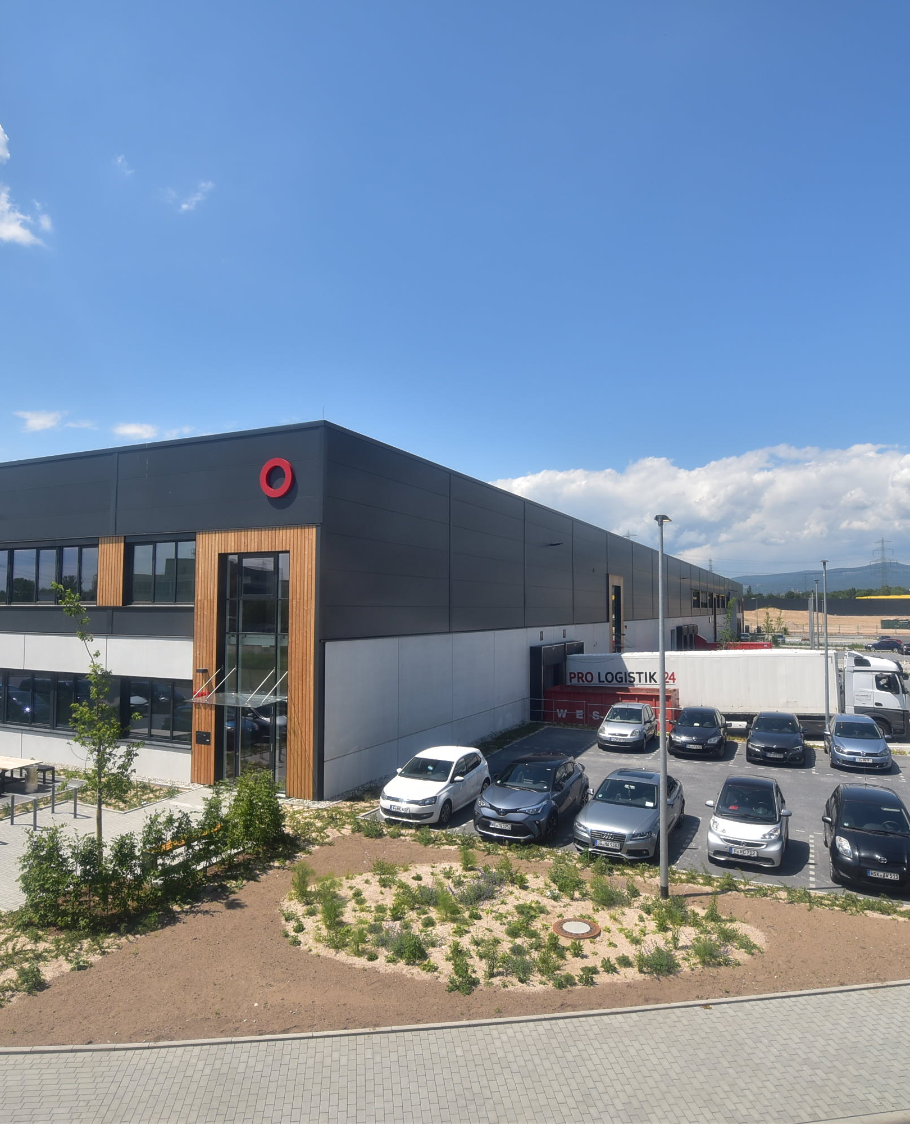
2022 Half year results
28 JULY 2022

Slide 2
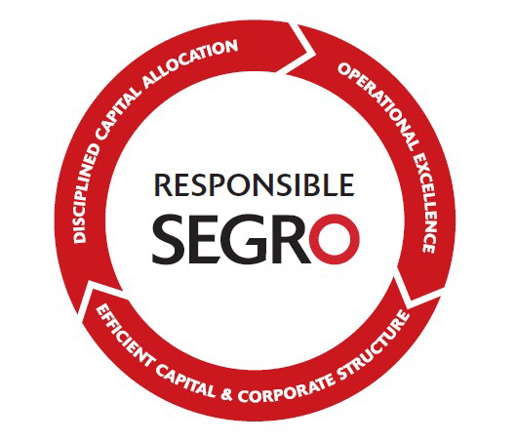
CLEAR & CONSISTENT STRATEGY CONTINUES TO DELIVER
Portfolio valuation | +7.2%
ERV growth | +5.9%
Net investment | £548m
Like-for-like rental growth | +7.1%
Uplift on rent reviews and renewals | +24%
Occupancy | 97%
LTV ratio | 23%
Cost of Debt¹ | 1.8%
Debt Maturity¹ | 8.7 years
1 Proforma for US Private Placement signed in early July

Slide 3
Occupier outlook remains very positive
European 1H22 take-up 8% higher than 1H21¹
Low vacancy rate across all European markets²
Estimated H2 take-up
1 Source: Savills, Q2 2022 numbers are preliminary
2 Source: CBRE

Slide 4
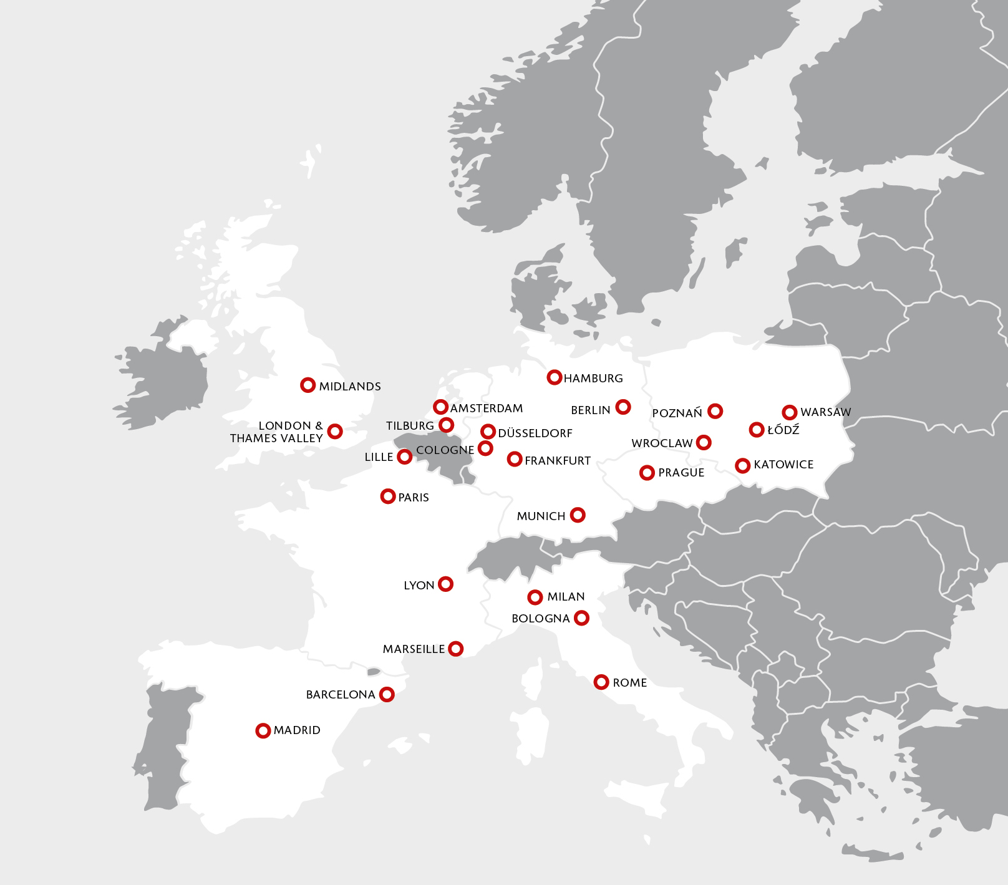
Prime modern Portfolio heavily weighted to urban markets
Portfolio split by geography and asset type
(at 30 June 2022)
AUM
£23.8bn
National Logistics
£2.0bn
Urban (67%)
Big box (31%)
Other
(2%)

Slide 5












































A very diversified and growing customer base
Customer sectors
(headline rent, SEGRO share)
  1,462 customers
  Top 20 customers = 32% of total group headline rent
  No single customer > 7% of total group headline rent

Slide 6

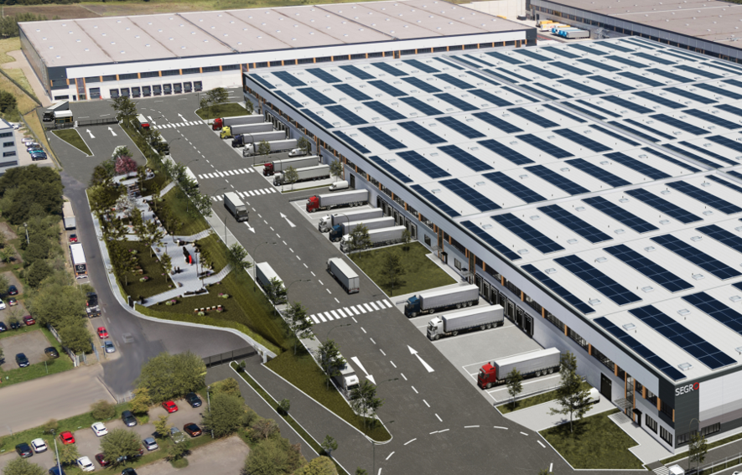
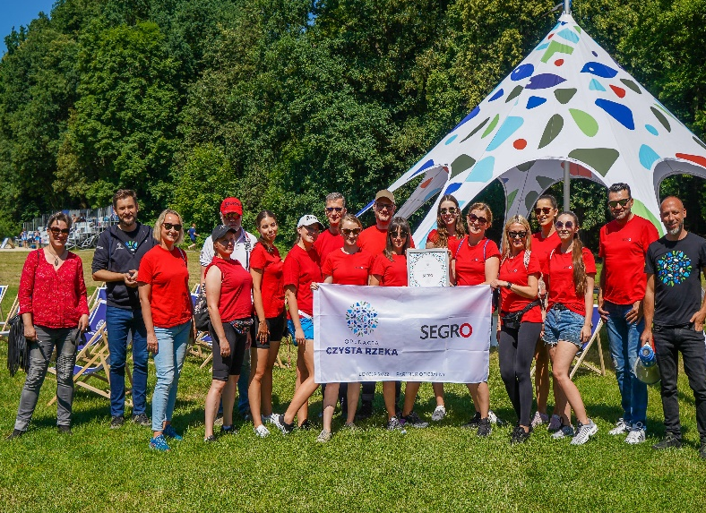
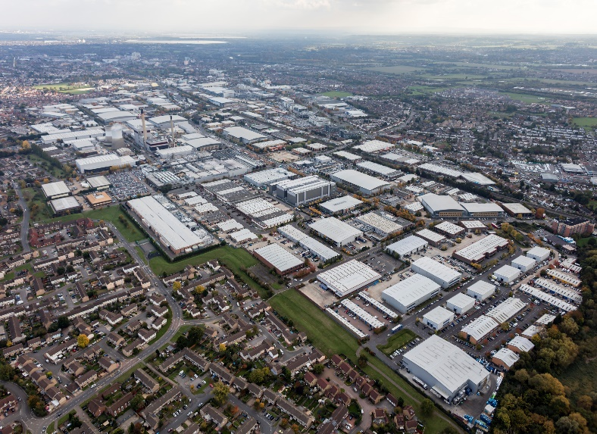


responsible segro increasingly integrated throughout the business
CHAMPIONING LOW-CARBON GROWTH
Retrofitting solar panels
Use of low-carbon concrete
INVESTING IN OUR LOCAL COMMUNITIES AND ENVIRONMENTS
NURTURING TALENT
SEGRO Day of Giving
Slough Community Investment Plan
Early careers/ diversity

Slide 7
WE CREATE THE SPACE THAT ENABLES EXTRAORDINARY
THINGS TO HAPPEN
Inflation-beating earnings growth
Delivering strong operational metrics
Disciplined approach to capital allocation
Confident outlook

Slide 8
WE CREATE THE SPACE THAT ENABLES EXTRAORDINARY
THINGS TO HAPPEN
Inflation-beating earnings growth
Delivering strong operational metrics
Disciplined approach to capital allocation
Confident outlook

Slide 9
Strong financial results
£216m
16.9p
8.1p
Adjusted profit before tax
+28.6%
Adjusted earnings per share
+22.5%
Excl SELP fee: 15.6p, +13.0%
Interim dividend per share
+9.5%
£20.5bn
1,249p
23%
Portfolio valuation (at share) +7.2%
Adjusted NAV per share
+9.8%
Loan to value

Slide 10
19% growth in net rental income
Proportionally consolidated net rental income (excluding joint venture fees), H1 2021-22, £ million
£17m
£21m
£255m
£(7)m
£(4)m
JVs
£52m
£14m
£214m¹
JVs
£47m
Like for like NRI
Group | +7.1%
UK | +8.9%
CE | +4.1%
Reversion
Indexation
Group
£167m
Group
£203m
2
3
1 H1 2021 comparables have been restated to reflect a change in the composition of net rental income to give a better measure of the underlying rental income in the property portfolio Management and development fee income, service charge income and expense and solar energy income and expense are now presented outside of the gross and net rental income
2 Other primarily includes properties taken back for development (-£2m) and impact of exchange rate (-£3m)
3 Proforma H1 22 net rental income can be found on slide 39

Slide 11
29% increase in Adjusted PBT
Adjusted income statement | H1 2022 £m | H1 2021 £m | Change
Gross rental income | 239 | 195¹
Property operating expenses | (36) | (28)¹
Net rental income | 203 | 167¹ | +22%
Joint venture fee income | 57 | 12
Other income | 3 | 4¹
Administration expenses | (31) | (27)
Share of joint ventures’ adjusted profit after tax² | 16 | 32
Adjusted operating profit | 248 | 188 | +32%
Net finance costs | (32) | (20)
Adjusted profit before tax | 216 | 168 | +29%
Adjusted EPS | 16.9 | 13.8 | +22%
Average share count | 1,204.2 | 1,194.1
SELP performance fee:
Recognised net £21 million in the period before tax related to the 10-year performance fee - 1.3p impact on EPS
Excluding that EPS would have been 15.6p (+13%)
See slide 39 for further information
Total cost ratio
Slightly higher at 20.5% (H1 2021: 19.8%)
18.7% excl share based payments (H1 2021: 17.4%)
1 H1 2021 comparables have been restated to reflect a change in the composition of net rental income to give a better measure of the underlying rental income in the property portfolio Management and development fee income, service charge income and expense and solar energy income and expense are now presented outside of the gross and net rental income. See Note 4 and 5 of the Financial Statements for further information
2 Net property rental income less administrative expenses, net interest expenses and taxation

Slide 12
£1.4BN VALUATION SURPLUS drives increase in nav
Portfolio value at 30 June 2022: £20.5bn
Portfolio
+7.2%
UK
+8.2%
Continental Europe
+5.2%
650p
Held throughout | 6.3% | 6.3% | 10.0% | 8.9% | 4.3% | 3.5% | 5.2% | 2.5% | 4.9%
Whole portfolio (including acquisitions, land & developments) | 7.2% | 6.3% | 11.7% | 10.3% | 5.7% | 4.2% | 6.0% | 2.9% | 4.0%

Slide 13
Driven by rental growth and asset management
Property yield²: 3.8%
6 month ERV growth: 5.9%
31 December 2021: 3.8%
H1 2021: 2.8%
+6.3% | UK: +7.3% H1 2021: +3.6%
+9.8%
+7.0%
+3.8% | Cont. Eur: +3.6% H1 2021: +1.5%
+3.2%
+1.8%
+4.6%
1 Yield on standing assets at 30 June 2022; ERV growth based on assets held throughout H1 2022
2 Net true equivalent yield

Slide 14
£2.1BN¹ of neW financing from diverse sources
SEGRO EMTN programme €1.15bn green notes issued | €650m 1.250% fixed coupon, due 2026 €500m 1.875% fixed coupon, due 2030
SEGRO US private placement €225m of new long-term debt arranged | €50m 3.87% fixed coupon, due 2037 €175m 4.14% fixed coupon, due 2042
SEGRO Term Loan Facility €1.0bn multicurrency facility | 2-year facility to provide additional liquidity to support SEGRO’s acquisition pipeline
SELP bilateral RCFs €100m additional committed facility | New bilateral facility conformed to existing syndicated RCF Total SELP RCF €600m, maturity 2026
SEGRO bank facilities extended €1.2bn facilities | SEGRO RCF extended, maturity 2027
1 Sterling equivalent, including JVs at share
Notes:
(1150+225+1000+50)/1.16 = 2,095m

Slide 15
No significant refinancing until 2026
Debt maturity by type and year, £ million
(as at 30 June 2022)
  Debt maturity 8.7 years¹
  (from 8.6 years at end-2021)
  Interest rate exposure¹
  78% fixed, 94% fixed or capped
1 Proforma for US Private Placement signed in early July

Slide 16
Low average cost of debt and leverage
  Credit rating A (Fitch senior unsecured)
  Net debt £4.8bn
  (FY 2021: £4.2bn)
  £2.1bn liquidity¹
  cash and available bank facilities
LTV ratio and average cost of debt
(incl share of joint ventures), 2014-22
¹
  Estimated development capex:
  2022: >£700 million
  Disposals:
  1-2% of GAV per annum
1 Proforma for US Private Placement signed in early July

Slide 17
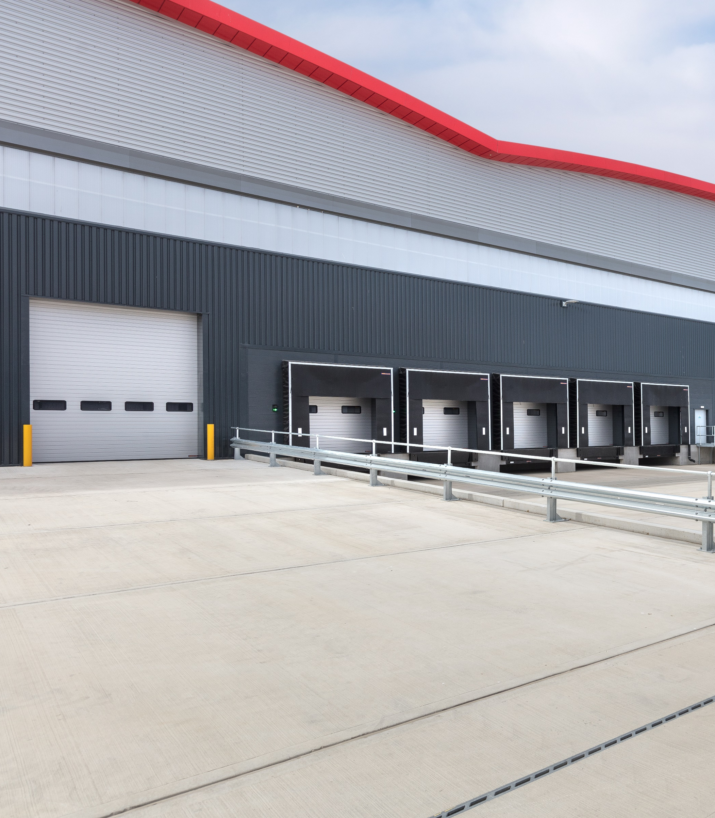
INFLATION-BEATING earnings growth
  13% earnings growth (ex SELP fee) driven by lettings, capture of reversion and development
  Significant rental growth
  7.1% like-for-like (vs H1 21)
  5.9% ERV growth (vs Dec 21)
  Low leverage and attractive debt profile
  2022 interim dividend increased by 9.5%
SEGRO Park Enfield, London

Slide 18
WE CREATE THE SPACE THAT ENABLES EXTRAORDINARY
THINGS TO HAPPEN
Inflation-beating earnings growth
Delivering strong operational metrics
Disciplined approach to capital allocation
Confident outlook

Slide 19
European vacancy at historic lows
Source: CBRE

Slide 20
Supply-demand dynamics point to further rental growth
Take-up continues to outpace supply in the UK
Breakdown of UK take-up by sector
Source: Savills

Slide 21







strong, deep and diverse occupier demand
Contracted rent¹
1 Net new rent on existing space reflects headline rent agreed on new leases less passing rent lost from space taken back during the year; new rent contracted is total headline rent secured or (in the case of developments) agreed in the year

Slide 22
Portfolio Delivering strong operating metrics
High levels of customer retention and
occupancy
Consistently capturing reversion from
renewals and reviews²
Occupancy = 97%
+24%
Retention = 79%
+12%
+10%
Retention
Occupancy
+5%
+3%
1 Occupancy rate based on ERV at 30 June 2022; customer retention rate based on headline rent retained in the same or alternative SEGRO premises
2 Uplift in 2019 and 2020 included re-gears on the peppercorn leases in the Heathrow portfolio so capture of reversion was higher – all of the re-gears have now been completed

Slide 23
SIGNIFICANT Reversionary potential already being captured
Lease event uplift opportunity¹
14
16
113
  Reversion captured so far in 2022
  £13 million
18
89
22
23
20
13
1 Reversion on let space only, excludes vacancy
2 Includes UK rent reviews, and UK and CE rent subject to break/ expiry – see p.14 of the Half Year 2022 Property Analysis Report for further detail .

Slide 24
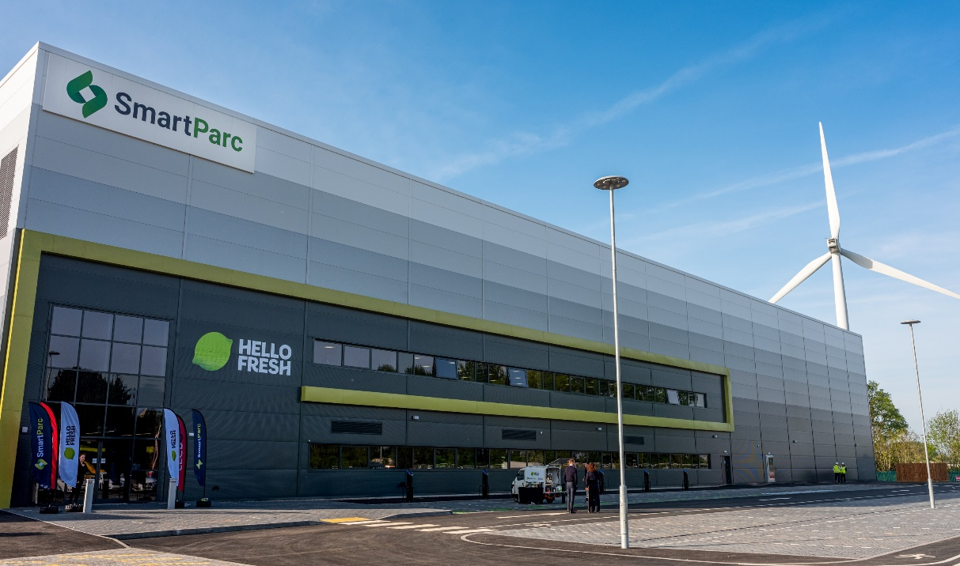
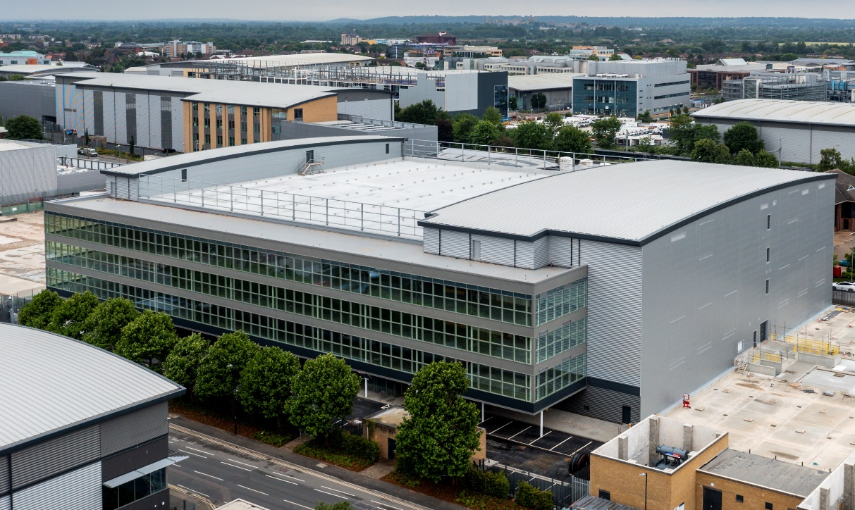

£15 million of new rent from development
  Space completed
  329,900 sq m
  Number of projects
  15
  Potential rent
  £15 million (87% leased)
  Yield on Cost
  7.3%
SmartParc SEGRO Derby
  We target at least BREEAM ‘Excellent’ (or local equivalent) on all of our developments.
Slough Trading Estate
SEGRO CityPark Frankfurt

Slide 25
WE CREATE THE SPACE THAT ENABLES EXTRAORDINARY
THINGS TO HAPPEN
Inflation-beating earnings growth
Delivering strong operational metrics
Disciplined approach to capital allocation
Confident outlook

Slide 26
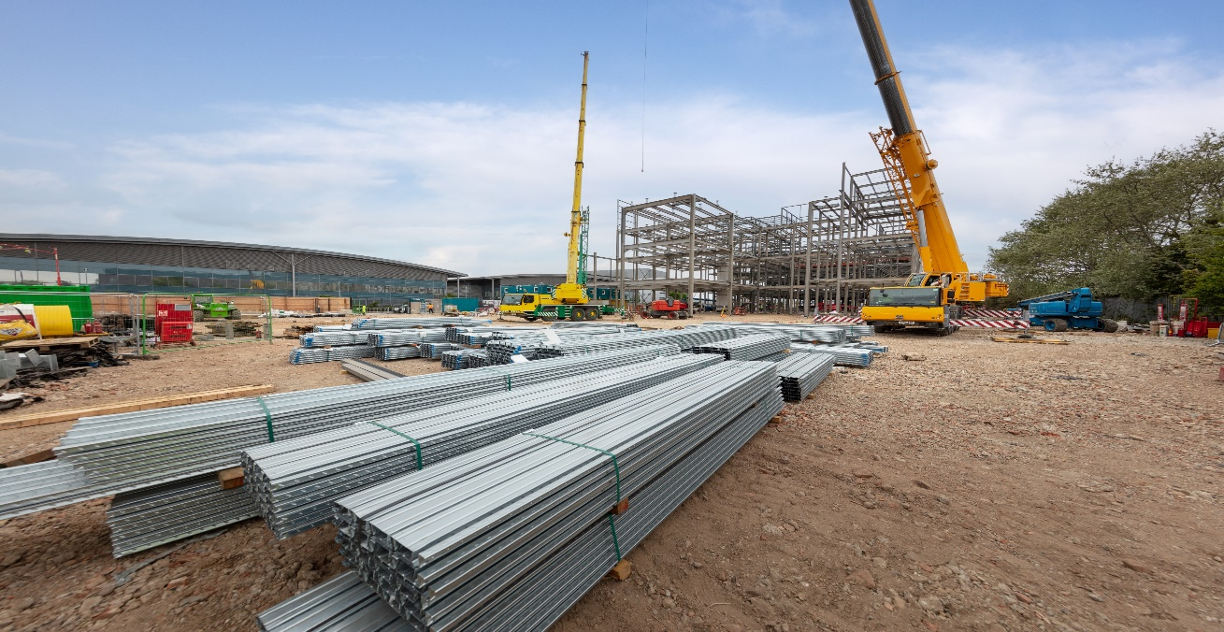
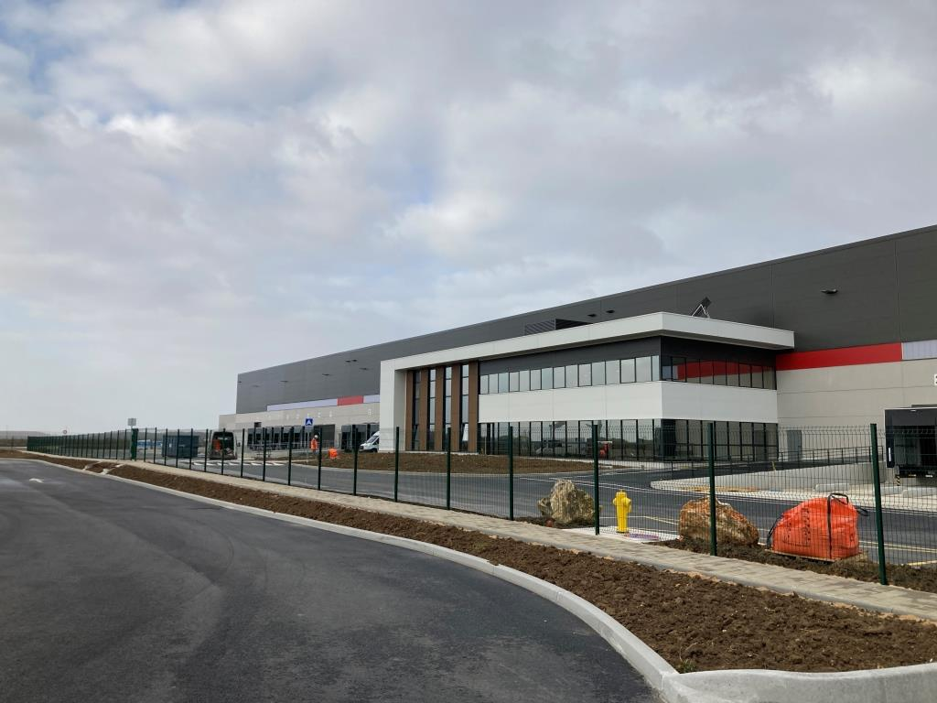
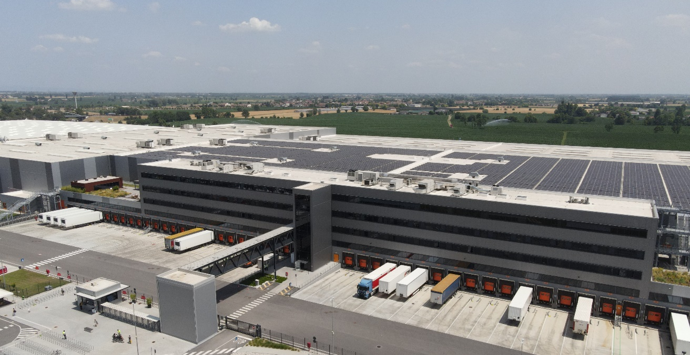
Continuing to be disciplined in our capital allocation
DEVELOPMENT
£284m of construction spend
£80m of infrastructure spend
ACQUISITIONS
£145m of asset acquisitions
£220m of land acquisitions
DISPOSALS
Big box warehouses in Italy
Asset swap to unlock redevelopment potential on the Slough Trading Estate
SEGRO sales to SELP
£364m
£365m
£181m

Slide 27
WE CREATE THE SPACE THAT ENABLES EXTRAORDINARY
THINGS TO HAPPEN
Inflation-beating earnings growth
Delivering strong operational metrics
Disciplined approach to capital allocation
Confident outlook

Slide 28


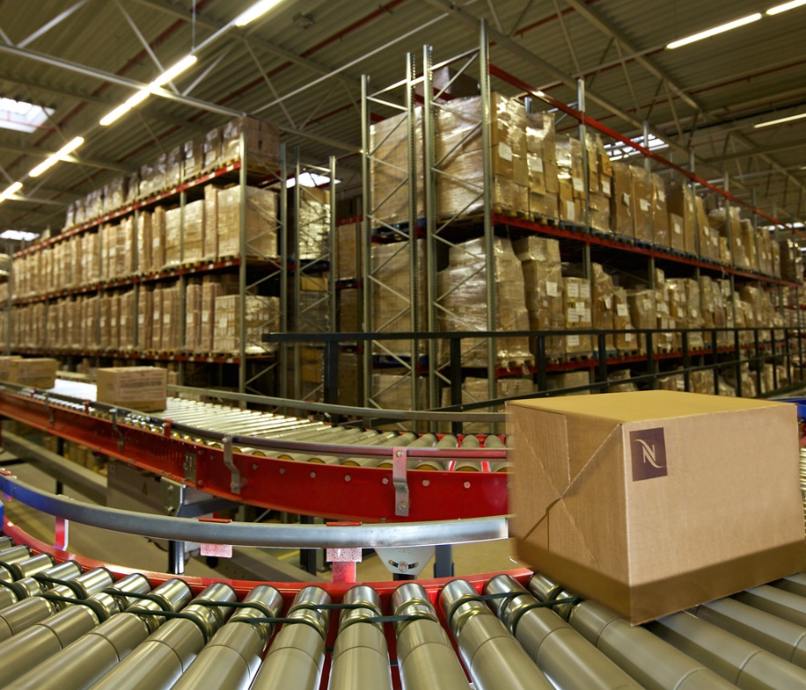

Supportive long-term structural drivers
DIGITALISATION
OF OUR
ECONOMIES
URBANISATION
SUPPLY CHAIN EFFICIENCY & RESILIENCE
SUSTAINABILITY

Slide 29
Demand-supply conditions REMAIN supportive of further rental growth
Property Type | Region | % of portfolio¹ | Demand conditions | Supply conditions | 1H22 ERV growth | ERV growth expectations
Urban warehouses | UK | 55% | STRONG | ACUTE | 7.4% | 3-6% pa
Row 2 | Continental Europe | 12% | STRONG | LIMITED | 2.6% | xx
Big box warehouses | UK | 9%² | STRONG | LIMITED | 6.6% | 2-4% pa
Row 4 | Continental Europe | 22% | STRONG | LIMITED | 4.5% | xx
…£139m of reversionary potential to capture (including £26m of vacant space)
1 Percentage of portfolio based on valuations as of 30 June 2022. 2% of the portfolio in other uses of industrial land, e.g. self-storage, car showrooms, offices
2 Includes big box warehouses in the Midlands (within National Logistics) and South East England

Slide 30
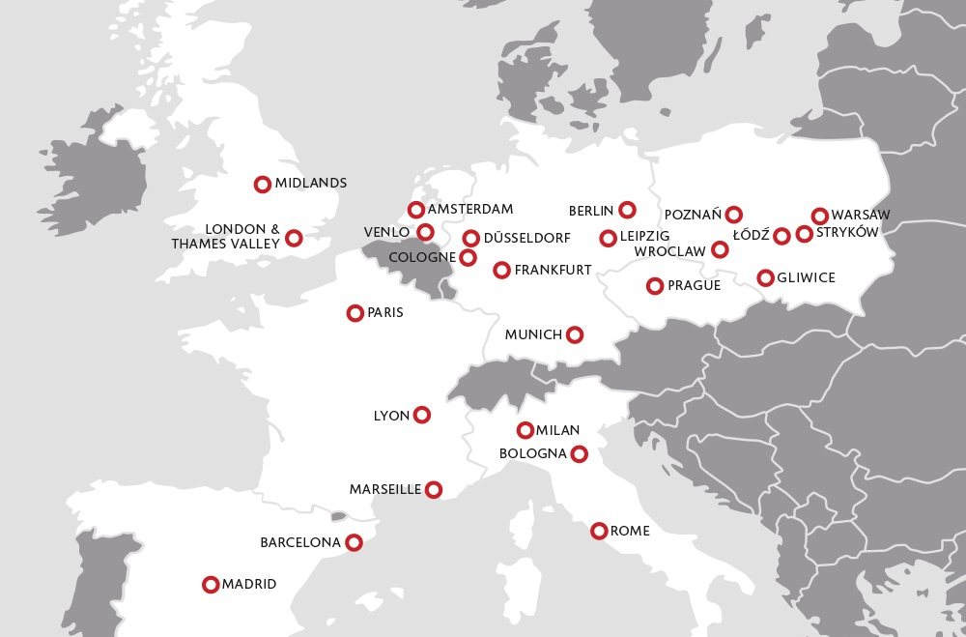
>£500 million of potential rental income from future development
SEGRO land bank (30 June 2022)
Development pipeline | Area (sq m) | Estimated cost to complete (£m) | Potential gross rent (£m) | Development yield³ | Proportion pre-let | Expected delivery
Current | 886,521 | 518² | 84 | 6.4% | 63% | 1-12 months
Near-term pre-lets¹ | 457,680 | 390 | 34 | 6.0% | 85% | 12-18 months
Future¹ | 2.8m | 2,080 | 216 | 6.4% | - | 1-7 years
Total | 4.1m | 2,988 | 334 | 6.4% | - | 1-10 years
Optioned land⁴ | c1.7m |  | c170 |  | - | 1-10 years
Potential annualised gross rent from current, near-term and future pipeline⁵, by asset type (£334 million at 30 June 2022)
Potential annualised gross rent from current, near-term and future pipeline⁵, by region (£334 million at 30 June 2022)
Other
(2%)
Big box (52%)
Urban (46%)
UK (66%)
Continental Europe (34%)
1 Future development pipeline in the 2022 Half Year Property Analysis Report. | 2 Total development cost of £1,313m including opening land value and capex already incurred
3 Estimated average yield on total development cost | 4 Land secured by way of options or conditional on contract | 5 Excludes optioned land
30

Slide 31
POTENTIAL >£1.2 BILLION RENTAL INCOME
Annualised gross cash passing rent¹, £ million
(as at 30 June 2022)
Potential from current activity: £307m
Potential from land bank and land options: £386m
170⁴
+128%
216⁴
1,233
34
+57%
84
139
847
50
Plus: further growth potential from redevelopment opportunities within the portfolio
540
Plus: further growth potential from rising ERVs and indexation
Passing rent at 30 June 22 | Rent in rent-free | Reversion (£113m) and vacant space (£26m) | Current development pipeline (63% let) | Near-term pre-let development opportunities^{2,3} | Total current potential | Future pipeline³ | Land held under option⁵ | Total potential
1 Including JVs at share | 2 Near-term development opportunities include pre-let agreements subject to final conditions such as planning permission, which are expected to commence within the next 12 months | 3 Total rent potential of £279m from near-term development opportunities and future pipeline
4 Estimated. Excludes rent from development projects identified for sale on completion and from projects identified as “Near-term opportunities”
5 Land secured by way of options or conditional on contract

Slide 32
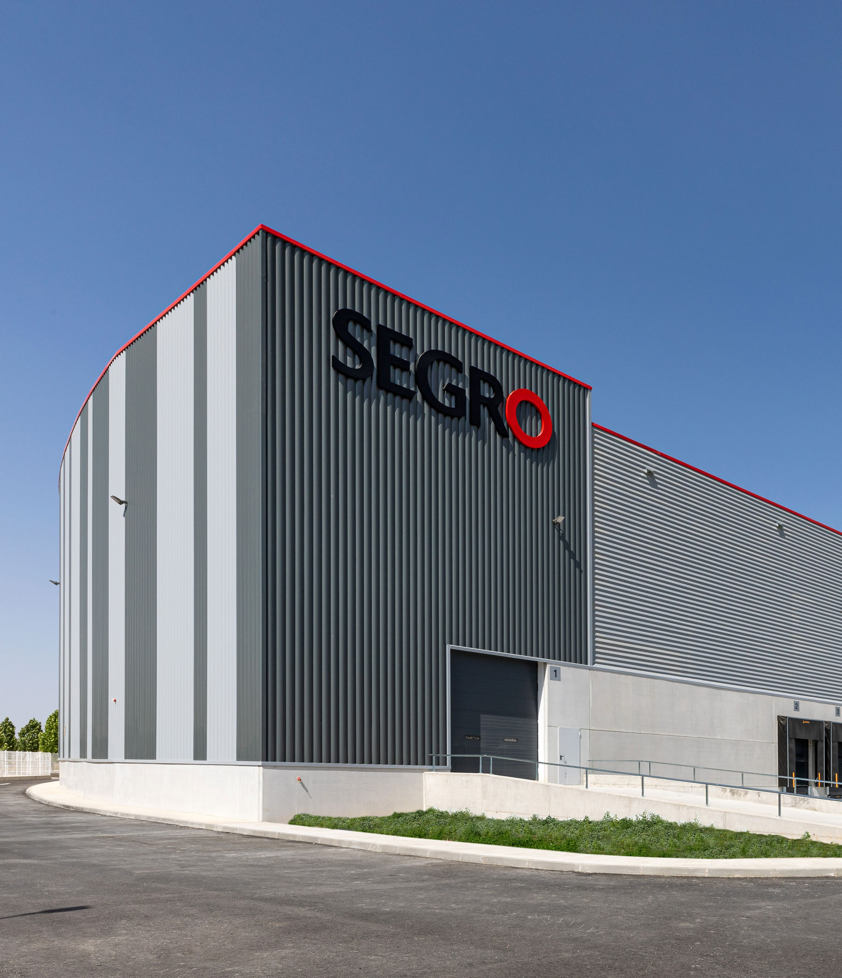




Confident outlook
Supportive structural trends
Restricted land availability limits supply response
Strong
balance
sheet
Market leading pan-European operating platform
Prime portfolio
of existing assets
Exceptional landbank for development

Slide 33
WE CREATE THE SPACE THAT ENABLES EXTRAORDINARY
THINGS TO HAPPEN
Inflation-beating earnings growth
Delivering strong operational metrics
Disciplined approach to capital allocation
Confident outlook

Slide 34
Q&A
2022 Half Year Results

Slide 35
Appendix 1
Portfolio and Financial Data

Slide 36
Positioning SEGRO to deliver on its purpose
Championing Low-carbon growth
Investing in our local
communities and environments
Nurturing talent
Context
Segro recognises that the world faces a climate emergency and we are committed to playing our part in tackling climate change, by limiting global temperature rise to less than 1.5 degrees, in tandem with growth in our business and the wider economy.
SEGRO is an integral part of the communities in which it operates, and we are committed to contributing to their long-term vitality.
SEGRO’s people are vital to and inseparable from its success, and we are committed to attracting, enhancing and retaining a diverse range of talented individuals in our business.
Targets
We will be net-zero carbon by 2030
We will create and implement Community Investment Plans for every key market in our portfolio by 2025
We will increase the overall diversity of our own workforce throughout the organisation
Actions
We will aim to reduce carbon emissions from our development activity and the operation of our existing buildings, and eliminate them where possible.
We will implement plans to absorb any residual carbon
We will work with our customers and suppliers
to support our local businesses and economies.
We will help improve the skills of local people to enhance their career and employment opportunities, by investing in local training programmes.
Equally, we will enhance the spaces around our buildings, working with local partners to ensure
we meet the needs of our communities.
We will provide a healthy and supportive working environment, develop fulfilling and rewarding careers, foster an inclusive culture and build diverse workforce.

Slide 37
Adjusted income statement
(JVs proportionally consolidated)
 | H1 2022 |  |  | H1 2021
 | Group £m | JVs £m | Total £m | Group £m | JVs £m | Total £m
Gross rental income¹ | 239 | 56 | 295 | 195 | 51 | 246
Property operating expenses | (36) | (4) | (40) | (28) | (4) | (32)
Net rental income | 203 | 52 | 255 | 167 | 47 | 214
JV management fee income² | 57 | (27) | 30 | 12 | (5) | 7
Other income | 3 | 1 | 4 | 4 | 1 | 5
Administration expenses | (31) | (1) | (32) | (27) | (1) | (28)
Adjusted operating profit | 232 | 25 | 257 | 156 | 42 | 198
Net finance costs | (32) | (7) | (39) | (20) | (6) | (26)
Adjusted profit before tax | 200 | 18 | 218 | 136 | 36 | 172
Tax and non-controlling interests | (12) | (2) | (14) | (3) | (4) | (7)
Adjusted profit after tax | 188 | 16 | 204 | 133 | 32 | 165
1 The composition of gross and net rental income has changed in 2022 to give a better measure of the underlying rental income from the property portfolio. Management and development fee income; service charge income and expense; and solar energy income and expense are now presented outside of gross and net rental income. Details of the change is disclosed further in Note 4, 5 and 6 of the financial statements
2 The management fees earned from joint ventures are recorded at 100% in SEGRO’s income statement (H1 2022: £15 million; H1 2021 £12 million). As a 50% owner of the joint ventures,
SEGRO’s share of JV income includes approximately half the cost of these fees in JV property operating expenses (H1 2022: £6 million; H1 2021 £5 million)

Slide 38
Impact of selp 10-year performance fee
Adjusted income statement | H1 2022 £m | Impact of SELP performance fee £m | H1 2022 excl SELP performance fee £m
Gross rental income | 239 |  | 239
Property operating expenses | (36) |  | (36)
Net rental income | 203 |  | 203
Joint venture fee income | 57 | (42) | 15
Other income | 3 |  | 3
Administration expenses | (31) |  | (31)
Share of joint ventures’ adjusted profit after tax¹ | 16 | 21² | 37
Adjusted operating profit | 248 |  | 227
Net finance costs | (32) |  | (32)
Adjusted profit before tax | 216 | (21) | 195
Tax | (12) | 5 | (7)
Adjusted profit after tax | 204 | (16) | 188
Adjusted EPS | 16.9p | (1.3)p | 15.6p
SELP 10-year performance fee is potentially payable October 2023
Calculated based on 10-year IRR versus hurdle rate
Based on valuations at 30 June 2022 performance fee would be c€370 million (€185 million net as SEGRO owns 50 per cent of SELP)
€79 million has been recognised to date: €29 million in FY21 and €50 million in 1H22
In 1H22 this has a net impact of £21 million before tax (1.3 pence per share)
Remainder could be recognised in 2H22 and 2023
1 Net property rental income less administrative expenses, net interest expenses and taxation
2 FX rate £1:€1.16

Slide 39
Pro forma H1 2022 accounting net rental income
 | Group £m | JVs £m | Total £m
H1 2022 net rental income | 203 | 52 | 255
Half year impact of:
Disposals since 1 January 2022 | (3) | - | (3)
Acquisitions since 1 January 2021 | 1 | 1 | 2
Developments completed and let since 1 January 2021 | 3 | 1 | 4
One-off items | (7) | - | (7)
Pro forma H1 2022 net rental income | 197 | 54 | 251
  Pro forma H1 2022 net rental income assuming
  disposals, acquisitions and let developments
  completed as at 1 January 2022
  One-off items (e.g. rates refunds) removed
  Share of JV fee costs removed from
  JV net rental income (see slide 37)
  Net rental income would have been £4 million lower on this basis

Slide 40
TOTAL COST RATIO
Total cost ratio, Half year 2021-22 (proportionally consolidated)
Incl. joint ventures at share | Half year to 30 June 2022 £m | Half year to 30 June 2021¹ £m
Gross rental income (less reimbursed costs) | 294 | 245
Property operating expenses | 36 | 28
Administration expenses | 31 | 27
JV operating expenses | 11 | 10
Less reimbursed costs: JV management fees, management and other fees² | (18) | (16)
Total costs³ | 60 | 49
Of which share based payments | (5) | (6)
Total costs excluding share based payments | 55 | 43
Total cost ratio⁴ | 20.5% | 19.8%
Total cost ratio excluding share based payments³ | 18.7% | 17.4%
1 As detailed in Note 4 and 5, the composition of Gross rental income and Property operating expenses have changed in 2022. The prior-period comparatives have been represented in the table above to reflect the impact on the cost ratio calculation
2 Includes JV property management fee income of £15 million and management and other fees of £3 million (H1 2021: £12 million and £4 million respectively)
3 Total cost includes wholly-owned vacancy property costs of £4 million (H1 2021: £3 million) and share of JV vacant property costs of £nil million (H1 2021: £1 million)
4 Cost ratio percentages have been calculated using the figures presented in the table above in millions to one decimal place

Slide 41
Balance sheet
(JVs proportionally consolidated)
 | 30 June 2022 |  |  | 30 June 2021
 | Group £m | JVs £m | Total £m | Group £m | JVs £m | Total £m
Investment properties | 17,209 | 3,276 | 20,485 | 11,850 | 2,624 | 14,474
Trading properties | 57 | - | 57 | 47 | - | 47
Total properties | 17,266 | 3,276 | 20,542 | 11,897 | 2,624 | 14,521
Investment in joint ventures | 2,022 | (2,022) | - | 1,620 | (1,620) | -
Other net liabilities | (761) | (322) | (1,083) | (459) | (187) | (646)
Net debt | (3,832) | (932) | (4,764) | (2,275) | (817) | (3,092)
Net asset value¹ | 14,695 | - | 14,695 | 10,783 | - | 10,783
EPRA adjustments |  |  | 444 |  |  | 146
Adjusted NAV |  |  | 15,139 |  |  | 10,929
1 After minority interests

Slide 42
10% increase in Adjusted NAV¹
Components of Adjusted NAV change, 31 December 2021 to 30 June 2022
111p
1p
17p
1,249p
1,137p
(17)p
Standing assets: 82p
Land & development: 29p
1 Adjusted NAV is in line with EPRA NTA

Slide 43
EPRA performance measures
 | Half year to 30 June 2022 |  | Half year to 30 June 2021
 | £m | £p per share | £m | £p per share
EPRA Earnings | 204 | 16.9 | 165 | 13.8
EPRA NTA (Adjusted NAV) | 15,139 | 1,249 | 10,929 | 909
EPRA NRV | 16,520 | 1,363 | 11,868 | 987
EPRA NDA | 15,257 | 1,259 | 10,432 | 868
EPRA LTV | 25.1% | 2.9% | 23.9%
EPRA net initial yield |  | 2.9% |  | 3.5%
EPRA topped-up net initial yield |  | 3.2% |  | 3.8%
EPRA vacancy rate |  | 3.3% |  | 4.3%
EPRA cost ratio (including vacant property costs) |  | 20.5% |  | 19.8%
EPRA cost ratio (excluding vacant property costs) |  | 19.0% |  | 18.4%

Slide 44
EPRA capital expenditure analysis
 | Six months to 30 June 2022 |  |  | Six months to 30 June 2021
 | Group £m | JVs £m | Total £m | Group £m | JVs £m | Total £m
Acquisitions | 328 | 37 | 365 | 90 | 2 | 92
Development¹ | 330 | 34 | 364 | 327 | 37 | 364
Completed properties² | 17 | 4 | 21 | 16 | 5 | 21
Other³ | 16 | 5 | 21 | 8 | 5 | 13
Total | 691 | 80 | 771 | 441 | 49 | 490
  Just over 50% of completed properties capex was for major refurbishment, infrastructure and fit-out costs prior to re-letting which is expected to be value-enhancing rather than simply maintenance capex
1 Includes wholly-owned capitalised interest of £6 million (H1 21: £4 million) and share of JV capitalised interest of £nil (H1 21: £nil)
2 Completed properties are those not deemed under development during the year
3 Tenant incentives, letting fees and rental guarantees

Slide 45
Euro currency exposure and hedging
  €1.16:£1 as at 30 June 2022
  € assets 69% hedged by € liabilities
  €2,298m (£1,981m) of residual exposure – 13% of Group NAV
  Illustrative NAV sensitivity vs €1.16:
  +5% (€1.22) = -£94m (-c7.8p per share)
  -5% (€1.10) = +£104m (+c.8.6p per share)
Assets 69% hedged
  Loan to Value (on look-through basis) at €1.16:£1 is 23%,
  Sensitivity vs €1.16:
  +5% (€1.21) LTV -0.6%
  -5% (€1.10) LTV +0.6%
Income 26% hedged
  Average rate for 6 months to 30 June 2022 €1.19:£1
  € income 26% hedged by € expenditure (including interest)
  Net € income for the period €104m (£88m) – 42% of Group
  Illustrative annualised net income sensitivity versus €1.19
  +5% (€1.25) = -£4.2m (c.0.3p per share)
  -5% (€1.13) = +4.6m (c.0.4p per share)

Slide 46
Look-through loan-to-value ratio and cost of debt
30 June 2022 £m | 31 December 2019 £m | Weighted average cost of debt, %¹ |  | Fixed Interest Cover %¹
 | Gross debt, excluding commitment fees and non-cash interest | Gross debt, excluding commitment fees and non-cash interest | Net debt, including commitment fees and non-cash interest | Fixed Cover of Net debt | Fixed and Capped cover of net debt
Group gross borrowings | 3,923 | 1.9
Group cash & equivalents | (91)
Group net borrowings | 3,832 |  | 2.3 | 74% | 95%
Joint venture gross borrowings | 987 | 1.3
Joint venture cash & equivalents | (55)
Joint venture net borrowings | 932 |  | 1.7 | 92%
‘Look-through’ gross borrowings | 4,910 | 1.8
‘Look-through’ net borrowings | 4,764 |  | 2.2 | 78% | 94%
Total properties (including SEGRO share of joint ventures) | 20,470
‘Look-through’ loan to value ratio | 23%
¹Proforma for US Private Placement signed in early July

Slide 47
Urban and big box warehouses
– complementary asset types
  Urban warehouses (67%)
  Smaller units, generally <10,000 sq m
  Diverse range of uses (including ‘last mile’ delivery and datacentres)
  Increased demand as a result of population expansion and growth of the digital economy
  Development highly restricted by declining land availability
  Lower net income yields, greater asset management potential
  Highest rental growth prospects
  Big boxes (31%)
  Larger units, generally over 10,000 sq m
  Mainly used for bulk storage and distribution of goods
  Increased demand as a result of online retail and supply chain optimisation
  Higher availability of development land but development constrained by planning/ zoning challenges
  Higher net income yields, lower management intensity
  Lower rental growth prospects
Data as at 30 June 2022
Urban warehouses
Big box warehouses
Other¹
2%
UK
9%
CE
22%
UK
55%
CE
12%
  Future performance mainly driven by income yield and rental growth
  Future performance mainly driven by income yield, JV fees and development gains
1 Other uses includes offices and retail uses such as trade counters, car showrooms and self storage facilities

Slide 48
Enhanced, de-risked development programme
1 Capex on developments and infrastructure £m (SEGRO share)

Slide 49
Land bank provides optionality and opportunity for growth
135
86
109
68
(84)
(28)
(40)
(118)

Slide 50
SEGRO European Logistics Partnership (SELP) headline figures
  Land and assets
  €7.6bn
  Equivalent yield
  4.0%
  Capital value change
  5.7%
  ERV growth
  4.9%
  Headline rent
  €298m
  ERV
  €315m
  Occupancy rate
  99%
  LTV ratio
  28%

Slide 51
appendix II
Market Data

Slide 52
European industrial investment volumes
Source: CBRE

Slide 53
Prime logistics yields vs 10 year bond yields
Source: Prime yields CBRE, risk free rates as of Bloomberg (30 June 2022)

Slide 54
European industrial and logistics
— take-up statistics
Take-up of warehouse space – UK¹
(m sq m)
Take-up of warehouse space >5,000 sq m – France²
(m sq m)
Take-up of warehouse space >5,000 sq m – Germany³
(m sq m)
1 Source: Savills 2 Source: CBRE 3 Source: BNP Paribas Real Estate

Slide 55
European industrial and logistics
— availability statistics
UK warehouse space supply¹
(m sq m)
Vacant warehouse space >5,000 sq m – France²
(m sq m)
1 Source: Savills.
2 Source: CBRE.

Slide 56
Forward-looking statements and Disclaimer
This document has been prepared by SEGRO plc (SEGRO) solely for use at the presentation of SEGRO’s results announcement in respect of the period ended 30 June 2022 (the Results Announcement). For the purposes of this disclaimer, ‘Presentation’ shall mean this document, the oral presentation of the slides by SEGRO and related question-and-answer session and any materials distributed at, or in connection with, that presentation.
This Presentation is supplied for information purposes only and may not be reproduced or redistributed. This Presentation should be read in the context of the Results Announcement. No representation or warranty of any nature is given, nor is any responsibility or liability of any kind accepted by SEGRO or any of its Directors, officers, employees, advisers, representatives or other agents with respect to the completeness or accuracy of any information provided in this Presentation.
This Presentation may contain certain forward-looking statements with respect to SEGRO’s expectations and plans, strategy, management objectives, future developments and performance, costs, revenues and other trend information. Some of these forward-looking statements may be based on data provided by third parties. All forward-looking statements are subject to assumptions, risks and uncertainties. Many of these assumptions, risks and uncertainties relate to factors that are beyond SEGRO’s ability to control or estimate precisely and which could cause actual results or developments to differ materially from those expressed or implied by these forward-looking statements. Certain statements have been made with reference to forecast process changes, economic conditions and the current regulatory environment. Any forward-looking statements made by or on behalf of SEGRO are based upon the knowledge and information available to Directors as at the date of the statement. Accordingly, no assurance can be given that any particular expectation will be met and you are cautioned not to place reliance on the forward-looking statements. Additionally, forward-looking statements regarding past trends or activities should not be taken as a representation that such trends or activities will continue in the future. The information contained in this Presentation, including information provided by third parties, is given as at the date of this Presentation and is subject to change without notice. Other than in accordance with its legal or regulatory obligations (including under the UK Listing Rules and the Disclosure Guidance and Transparency Rules of the Financial Conduct Authority), SEGRO does not undertake to update any forward-looking statements, including to reflect any new information or changes in events, conditions or circumstances on which any such statement is based. Past share performance cannot be relied on as a guide to future performance. Nothing in this Presentation should be construed as a profit estimate or profit forecast.
This Presentation does not constitute an offer to sell or an invitation to buy securities in SEGRO or an invitation or inducement to engage in or enter into any contract or commitment or other investment activity. No part of this Presentation, nor the fact of its distribution, should form the basis of, or be relied on in connection with, any contract or commitment or investment decision whatsoever.

